Slide 1

AUTOMOBILE SALES TREND ANALYSIS
Name : Barath S P
Mentor : Jaya Pandey

Slide 2
INTRODUCTION
This analysis delves into the company’s sales and pricing strategies, leveraging a series of visualizations to uncover key insights.
By examining product line performance, pricing trends, seasonal patterns, and order status metrics, we aim to identify opportunities for optimization and improvement.
By understanding these initial insights, we can delve deeper into the data to uncover additional trends and patterns.

Slide 3
OBJECTIVE
This presentation aims to analyze the company's sales and pricing strategies by examining various metrics and trends.
By visualizing key insights, we seek to identify opportunities for improvement and optimize future business decisions.
The analysis will focus on product line performance, pricing strategies, seasonal trends, and order fulfillment.
By understanding these factors, we can develop effective strategies to boost sales and enhance customer satisfaction.

Slide 4
BUSINESS RELATED QUESTION

Slide 5
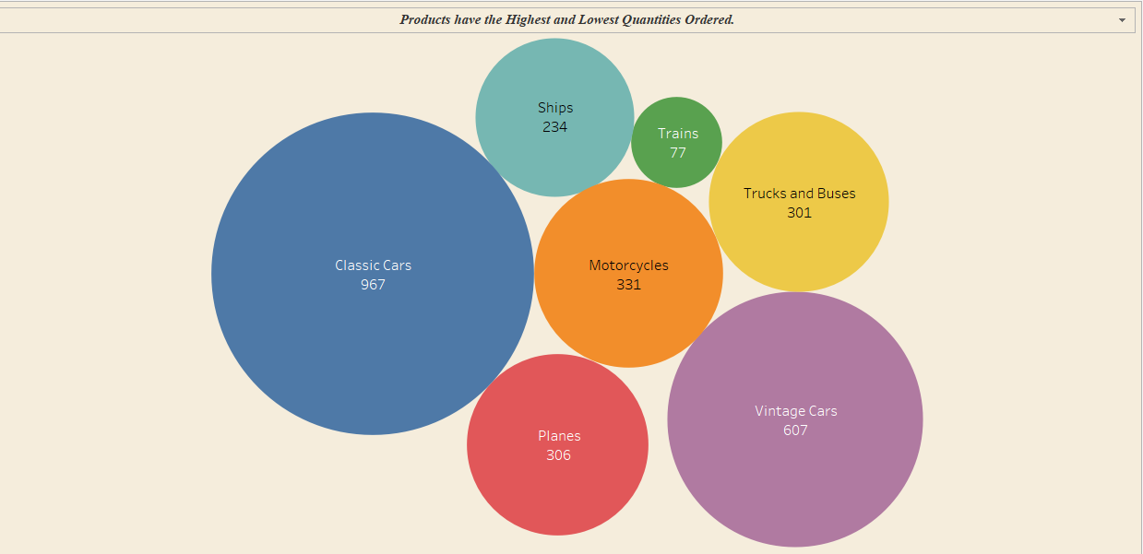
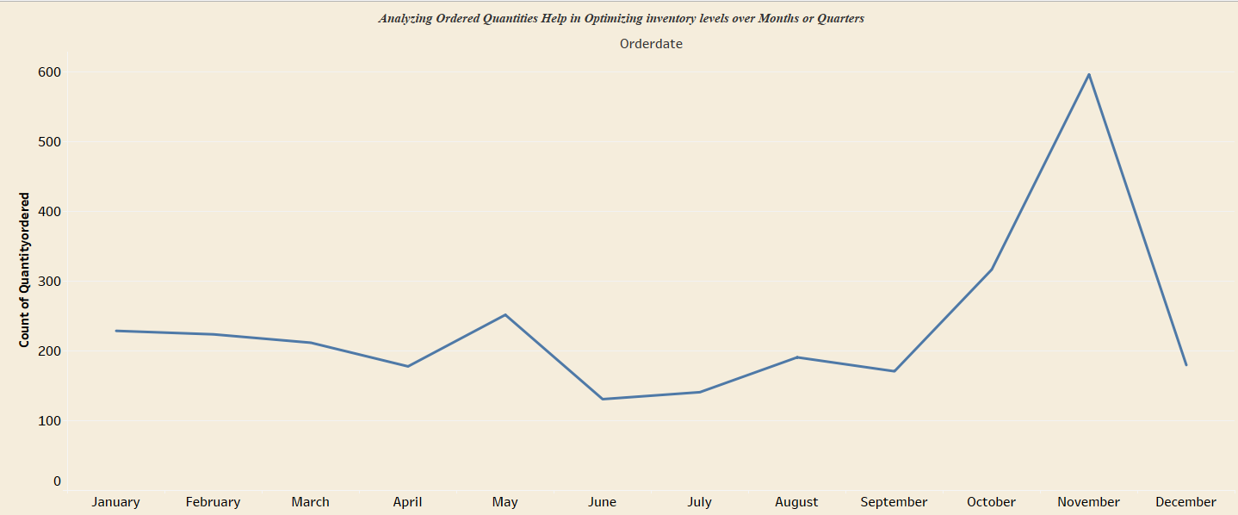
1(A) Products have the Highest and Lowest Quantities Ordered.
Classic Cars is the Highest Quality Ordered followed By Vintage Cars and Trains is the Lowes
1(B) Analyzing Ordered Quantities Help in Optimizing inventory levels over Months or Quarters
November Month is the Peak selling Month for all products and June Month is the Least selling Month.

Slide 6
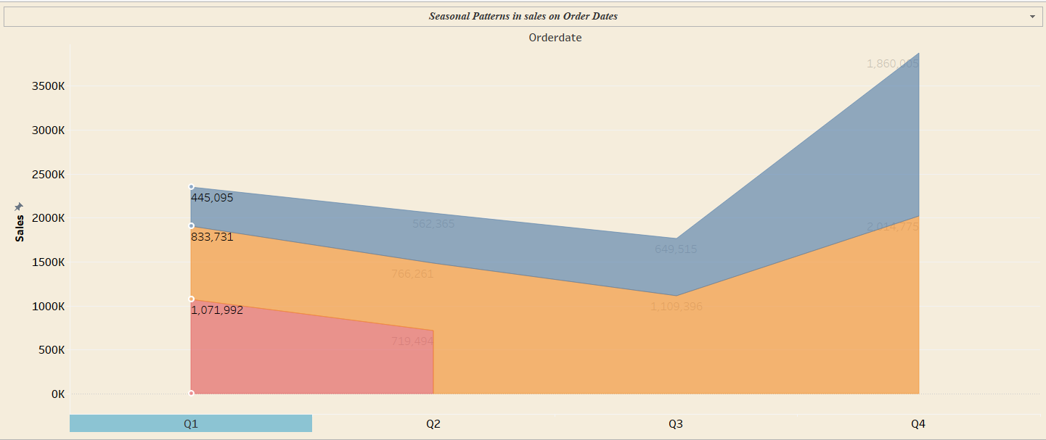
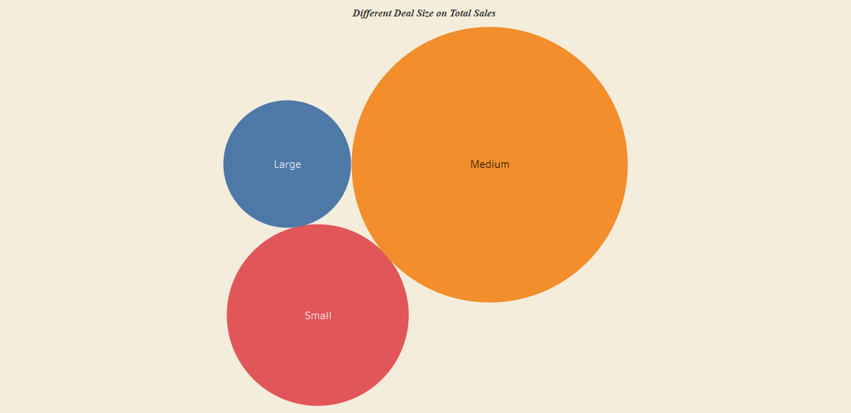
1(c) Seasonal Patterns in sales on Order Dates
In all the Years the Q4 is the Peak Season in terms of sales and quantities Ordered followed By Q3.
1(D) Impact of Different deal size on Total Sales
Medium is one of the part of Deal size .It is creating impact on all other Deal size in terms of Sales.

Slide 7
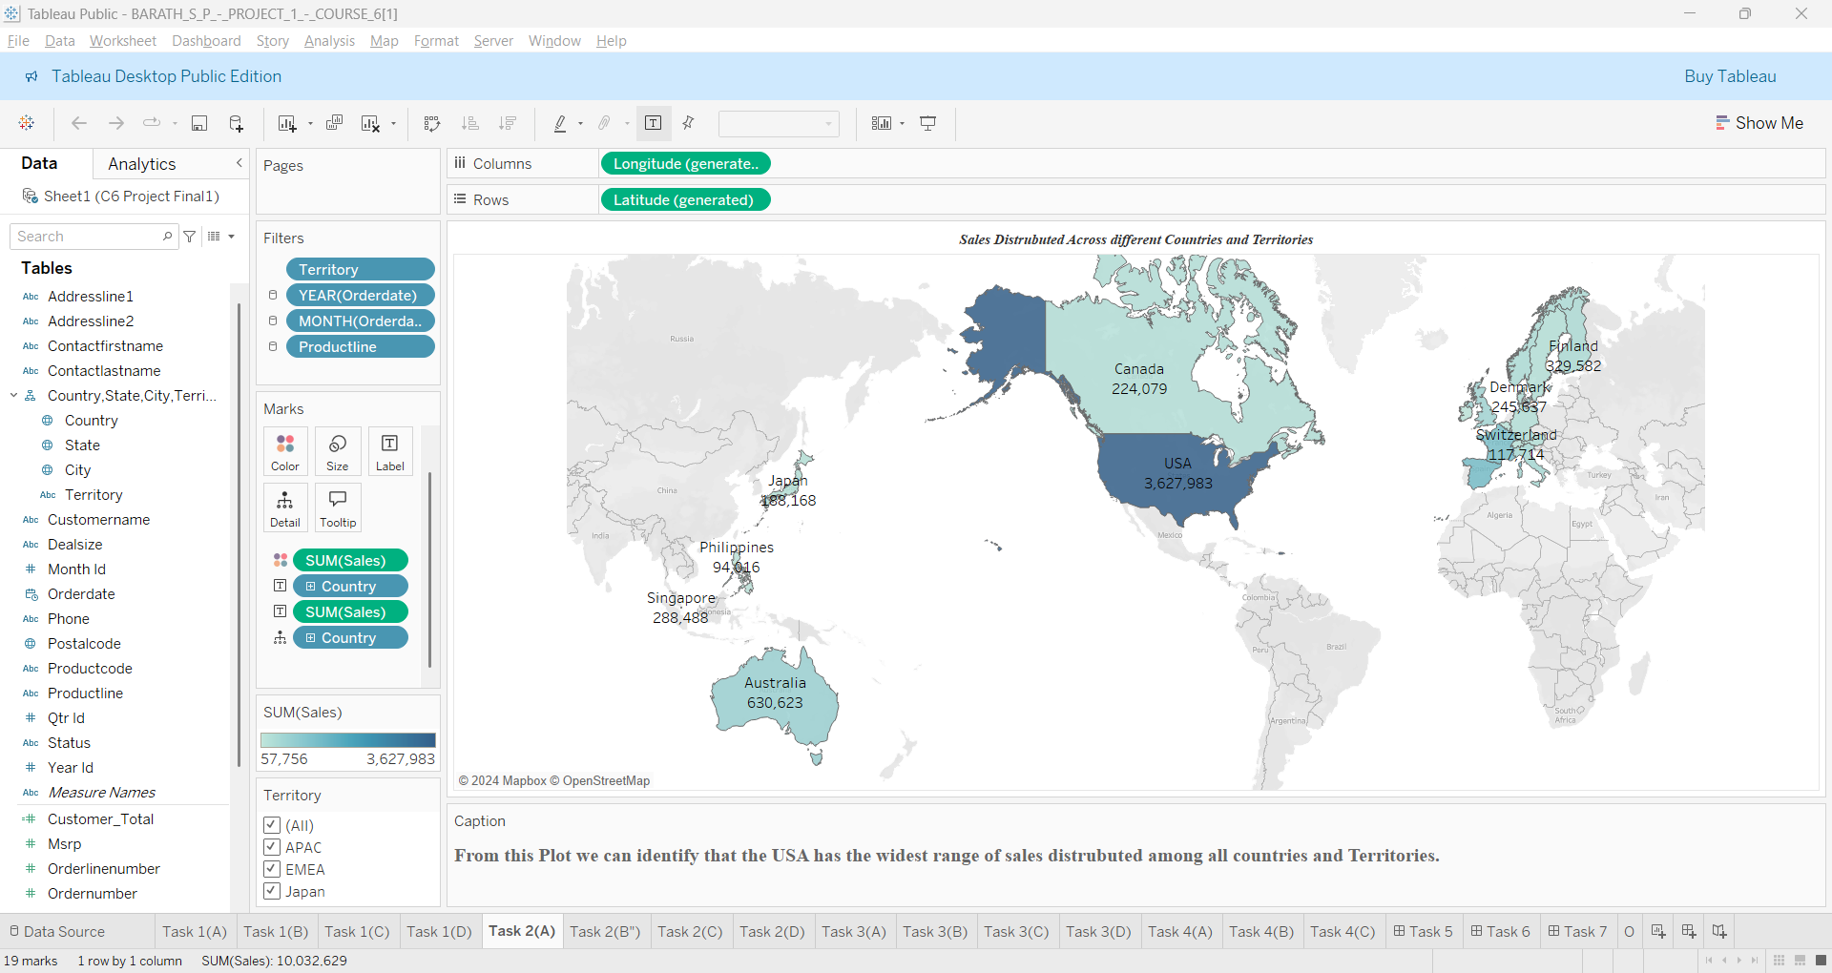
2(A) Sales Distributed Across different Countries and Territories
USA Country has the widest range of sales distribution when compared to all other states and Territories.

Slide 8
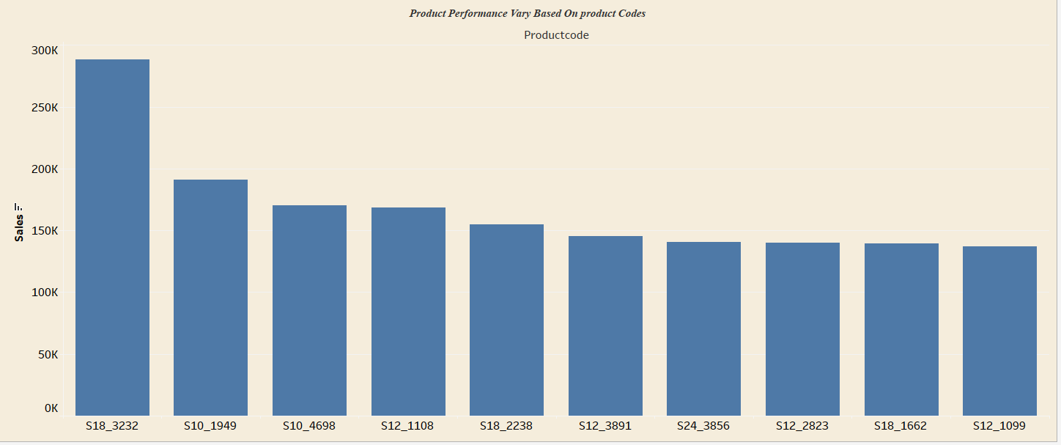
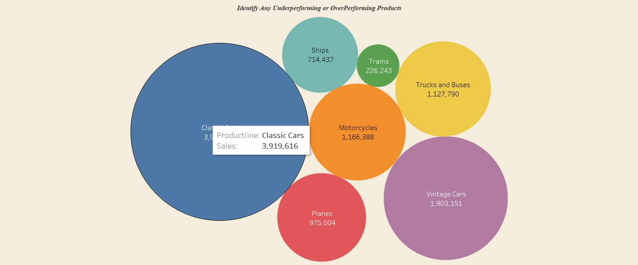
4(B) Product Performance Vary Based On product Codes
The product Code “S18-3232” Has doing performing in terms of sales and followed by “S10_1949” .
4(D) Identify any underperforming or Overperforming Products.
The classic Cars is one of the Products is performing beyond its Limit And The Train is one of the Products which is does n’t perform well in terms of sales

Slide 9

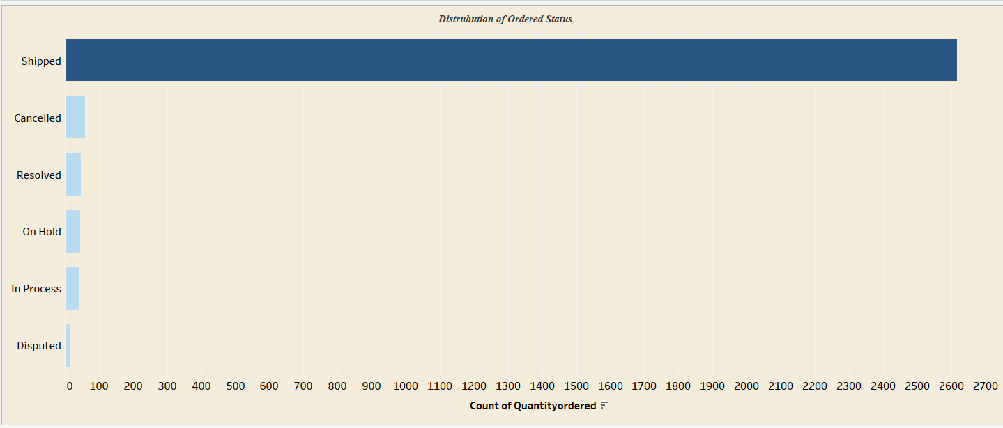
1(1)Products have the Highest And Lowest Quantities Ordered.
Classic Cars is the product which has been Ordered Highly When Compared to all other Products .Vintage Cars is the order after Classic Cars.
1(2) Distribution of Ordered Status
Most of the Products are in Shipped Status and Very Few status are disputed Status

Slide 10
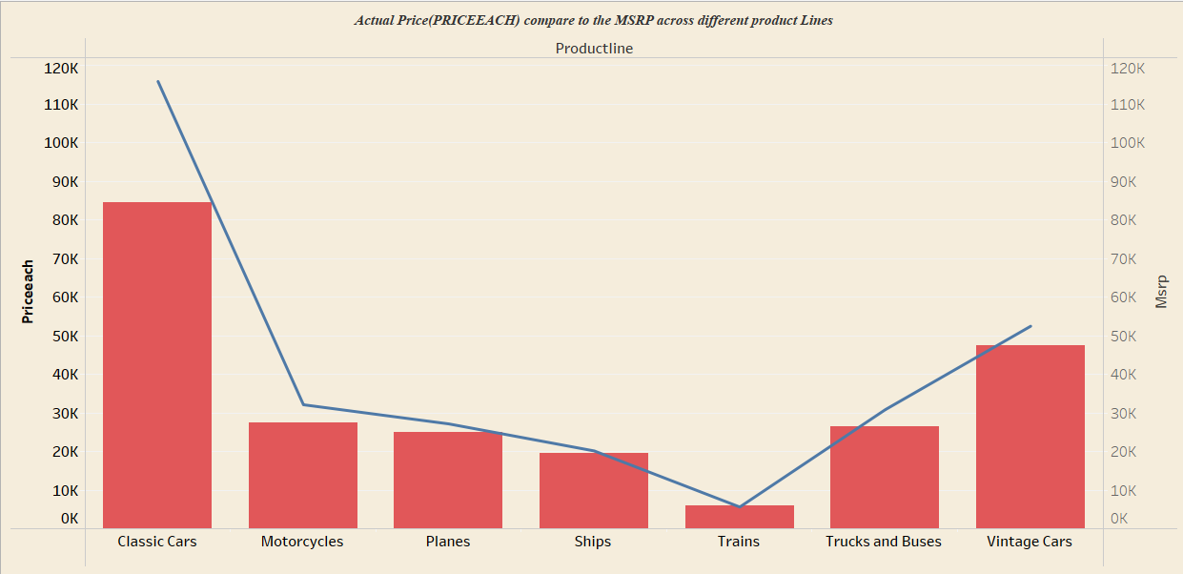
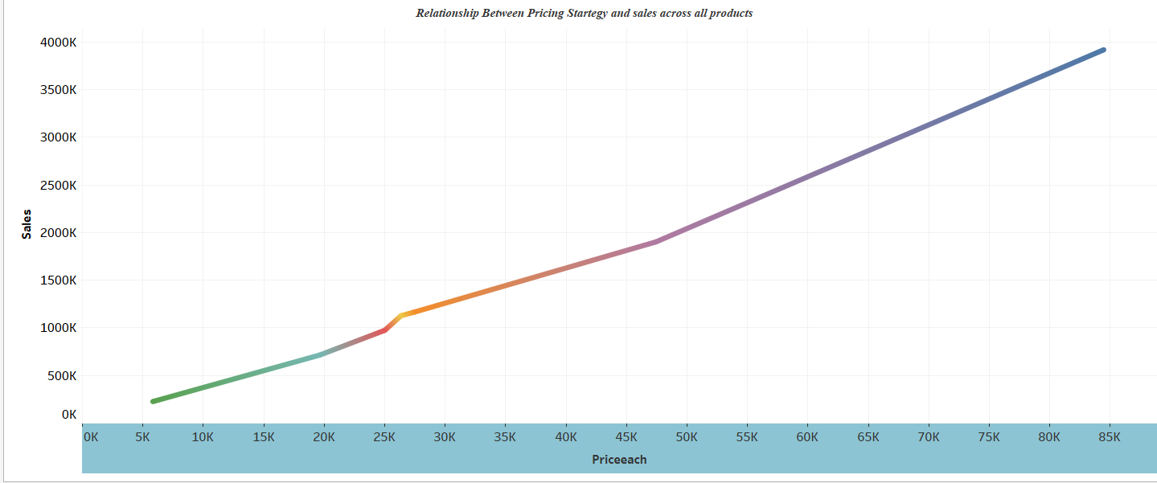
1(3)Actual Price(PRICEEACH) compare to the MSRP across different product Lines
Actual price (Price Each) is generally lower than the MSRP (Manufacturer's Suggested Retail Price) for all product lines except for Vintage Cars, where the actual price is higher than the MSRP.
1(4) Relationship Between Pricing Startegy and sales for all the Products
It shows a positive correlation between price and sales across all products.

Slide 11
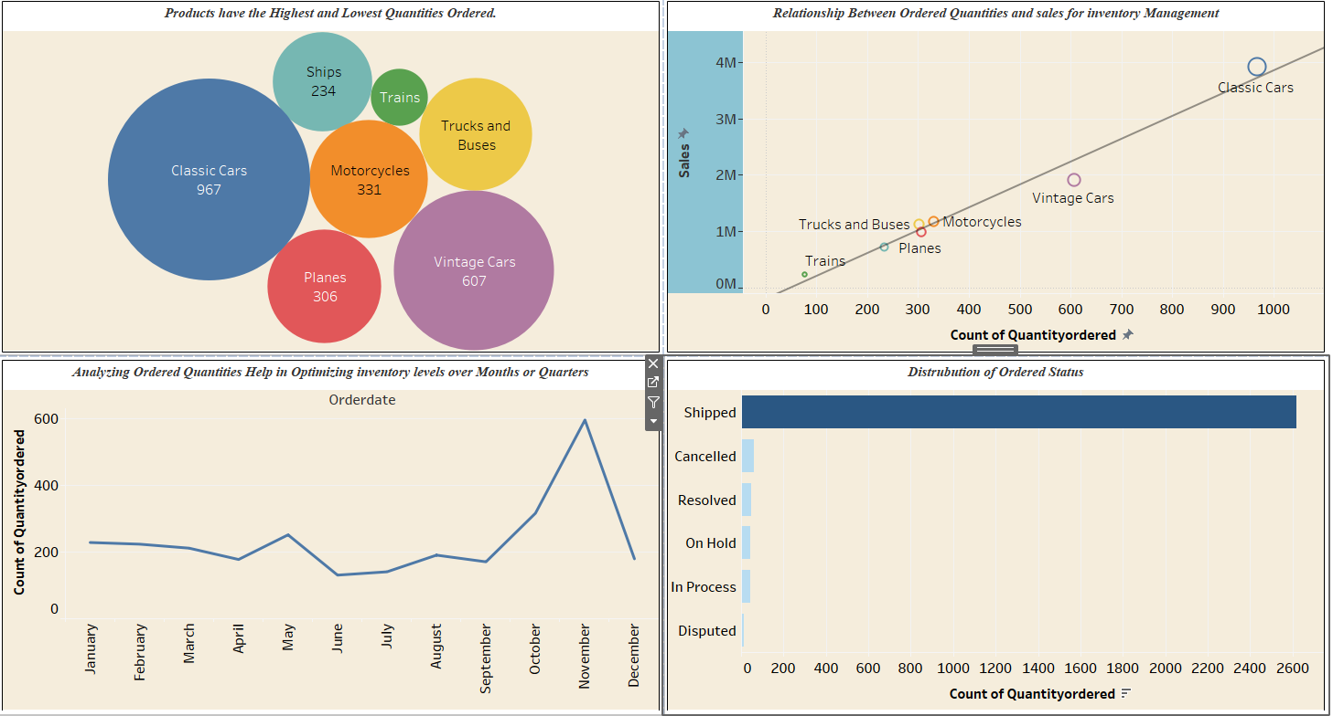
Stock And Order Analysis
From this The classic cars is the Highest Quantity Ordered Products and Trains is the lowest Quantity order Products .The sales for all the Products shows the Positivie correlation and November is month is the Most peak Month .Most of the Products is in Shipped Status.

Slide 12
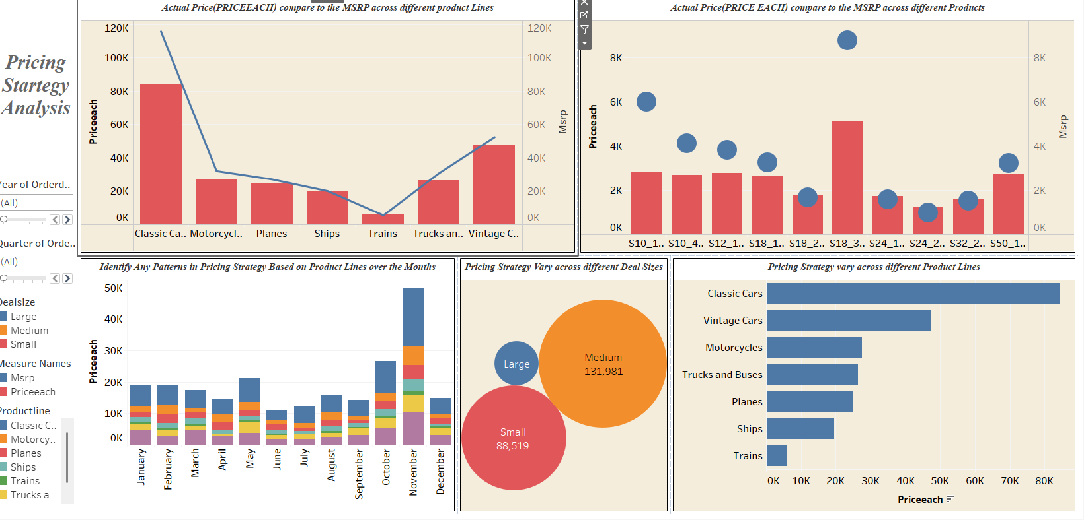
Pricing Strategy Analysis
From this we can ensure that The classic Cars is performing well in terms of sales and Quantities Ordered .The Medium Deal size is mostly Liked deal size because the Medium deal is mostly Ordered From all Countries and Territories. The November is the Most Sales Month .

Slide 13
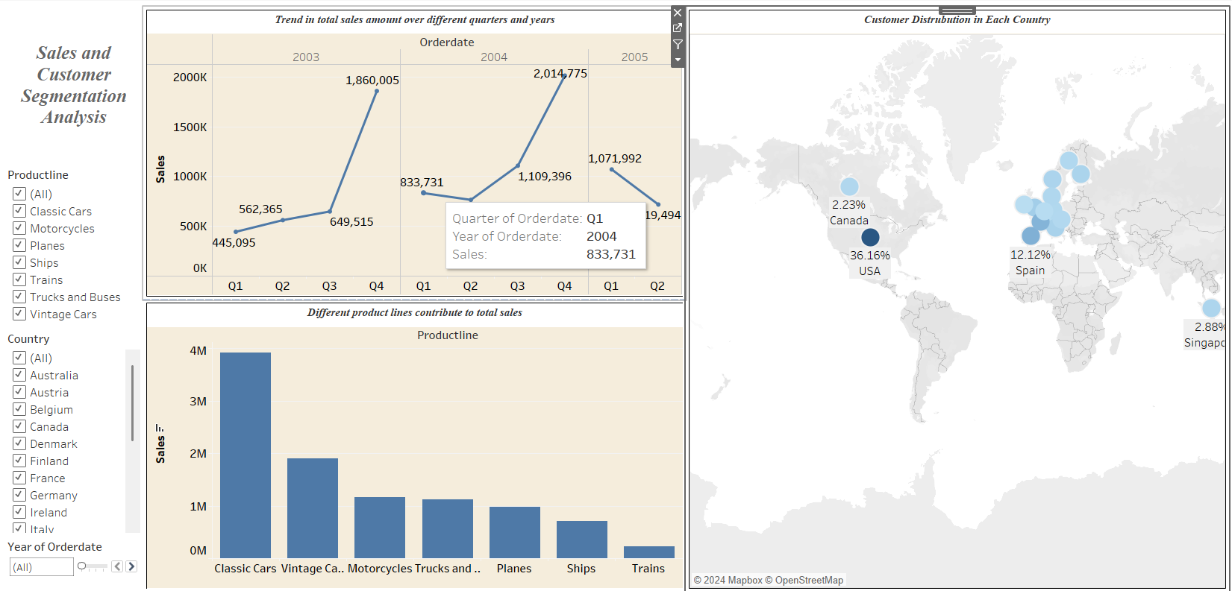
Sales and Customer Segmentation Analysis:
From this analysis for all the years the Quarter 4 is the Most Peak Month and Classic Cars is the Most contribute to the Company in terms of sales and The USA Country is Most ordered compared to all other Countries.

Slide 14
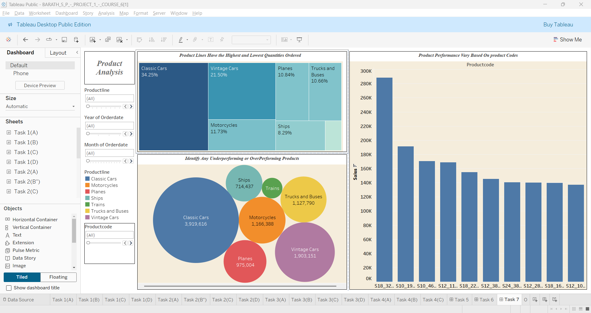
Product Analysis
From this We can Analyse that Classic Cars is most Performing Product and The S18_3232 IS the most perform well in The Market

Slide 15
SUMMARY:
The year 2003 and 2004 saw the highest sales in Quarter 4 for all products compared to other quarters.
Among all the Products Lines The classic Cars serves as a Highest Selling Product Line .
When compared to all other Months for all the years The November Month is the Highest selling For all The products Lines.
Medium Deal Size is creating Impact for all other Deal Size in terms of Sales.
The USA Country Customer has Purchased the Products frequently when compared to all other Countries and Territories.
Classic Cars are the most frequently ordered product by all other country people, followed by Vintage Cars.

Slide 16
Classic Cars is Overperforming product and Train is Underperforming Product in terms of Sales.
The Product Code “S18_3232” Has the one which performs well In terms of sales followed by “S10_1949”
Most of the Products are In Shipped Status. Very Few Product Line are in Disputed Status.
In some Of the Products Line The Actual Price is generally Lower than the MSRP. For Vintage Car The actual Price is Higher than The MSRP.
This Actual Price And Sales shows a positive Correlation for all The Product Line

Slide 17
CONCLUSION
Strong Q4 Sales Performance
The years 2003 and 2004 consistently showcased peak sales in Quarter 4, underlining the importance of seasonal demand across all product lines.
Dominance of Classic Cars
The Classic Cars product line has proven to be the highest-selling category, showcasing its broad appeal and customer preference.
November: A Critical Month
Across all product lines and years, November emerged as the top-selling month, emphasizing the significance of targeted strategies for this period.
Impact of Medium Deal Size
Medium deal sizes have been a key driver of sales, outperforming other deal sizes and highlighting the need to optimize this segment.

Slide 18
5.USA as the Leading Market
Customers from the USA are the most frequent buyers, making it a vital market for sustained growth and strategic focus.
6.Product Popularity by Geography
Classic Cars remain the most frequently ordered product globally, followed by
Vintage Cars, appealing across diverse demographics and geographies.
7.Pricing Trends
In some product lines, the Actual Price is generally lower than the MSRP (Manufacturer's Suggested Retail Price), creating competitive pricing advantages. However, for Vintage Cars, the Actual Price exceeds the MSRP, possibly reflecting premium demand or market positioning.
8.Sales-Price Correlation
A positive correlation exists between Actual Price and Sales across all product lines, suggesting that customers are willing to pay more for perceived value or quality.

Slide 19
THANK YOU

